Slide 1

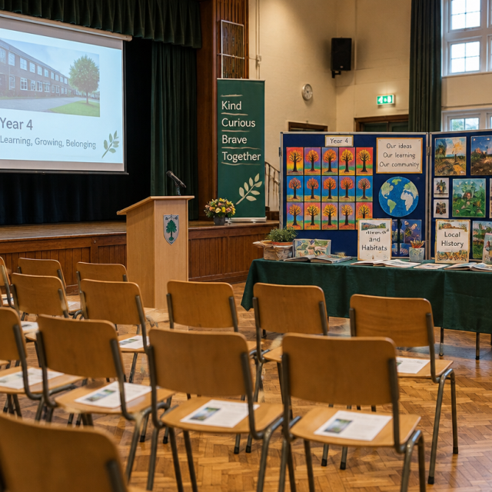
Year 4 Parent Information Evening
Grange Junior School: Academic year 2026-2027

Slide 2

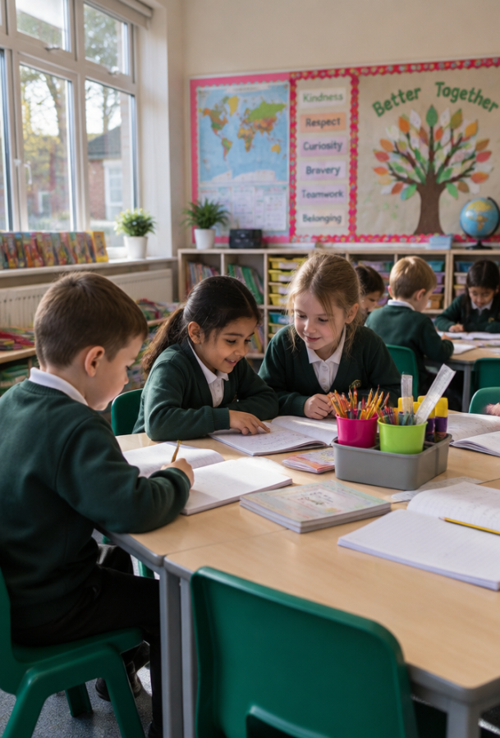
Welcome to Year 4
What makes Year 4 such a transformative and vibrant year for your child?

Slide 3
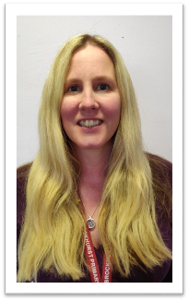

Meet the Year 4 Teaching Team
Dedicated Classroom Staff
Class 4JH: Mrs Hill and Mrs Harman
Class 4MM: Mr McDonagh, Mrs Chalmers, and Mrs Baker
Headteachers: Mrs Sadler and Mrs Harris
Our collaborative team works closely together across both classes to ensure consistent, tailored pastoral and academic support.

Slide 4
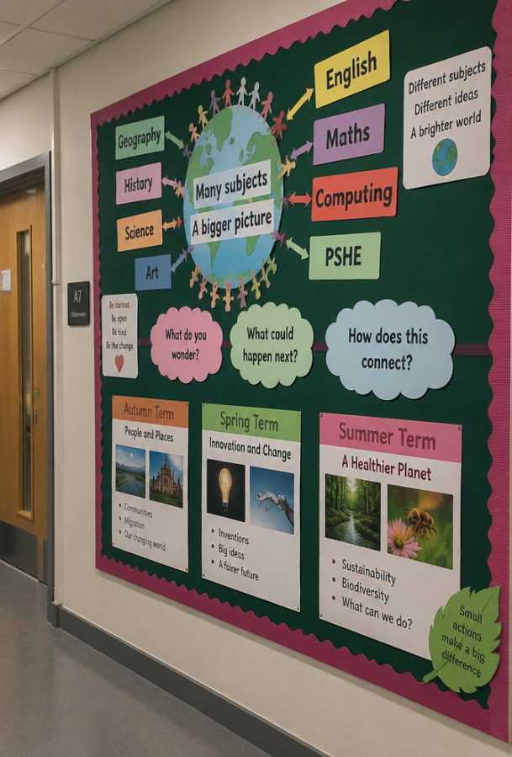
Our Dynamic Learning Journey
Connected, Meaningful Topics
We create half-termly curriculum maps linking history, science, art, and literacy. Find all maps on our Year 4 website hub.
🧠
Remember
Curriculum overviews adapt to pupil interests and progress throughout the year.

Slide 5
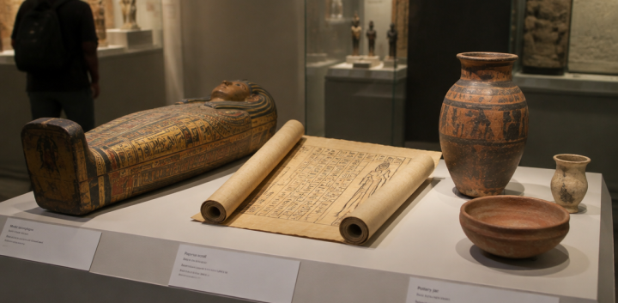
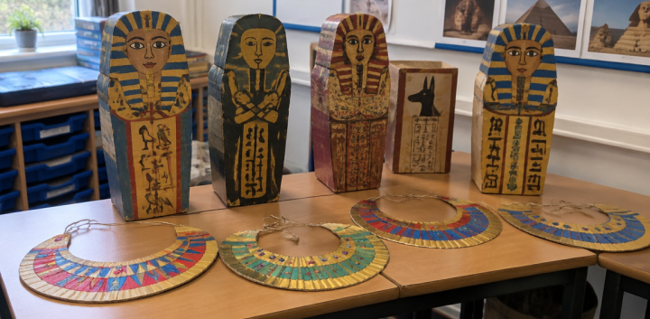
Autumn 1: Tomb Raiders Showcase
History & Science
History explores pharaohs, pyramids, and Egyptian daily life, linked directly to science investigations into mixtures, solutions, and filtration.
The Arts & Pop-Up Museum
Pupils craft jewellery and Tutankhamun masks, culminating in an interactive pop-up museum in the school hall for parents and peers.

Slide 6
Enriching Trips and Experiences
Spring Term
Proposed local coastal study and maritime heritage exploration.
Summer Term
Stubbington Study Centre (17th – 21st May)
outdoor education residential stay.
Autumn 2
Hands-on living history workshop exploring Saxon and Norse culture.
Summer Term
Fieldwork measuring freshwater flow and aquatic habitats.

Slide 7
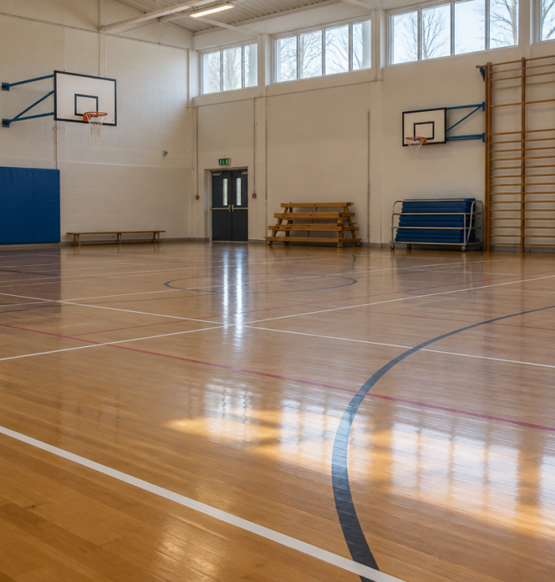
Physical Education Timetable
Scheduled Days
PE lessons take place every Tuesday and Thursday for both 4JH and 4MM.
Our Autumn 1 PE topics are Netball & Outdoor Adventure.
Pupils arrive at school wearing their PE kit and remain in it all day.
*Ensure suitable shoes are worn.
Ensure complete kits comply with standard school guidelines.
Water bottles are obtainable from the main office.

Slide 8
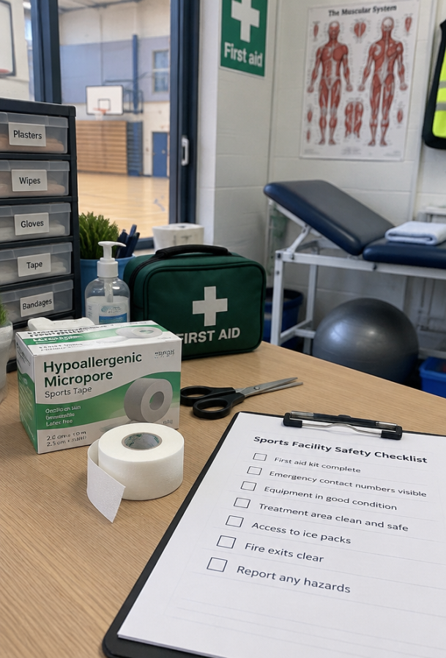
Physical Education Safety Protocol
Essential Jewellery Guidance
Safety rules protect pupils during sport.
Remove earrings for all PE lessons.
If unable, tape ears at home before school.
⚠️
Watch out
Staff cannot tape or remove earrings. Unprepared pupils will miss the session.

Slide 9




School Houses and Values
Sycamore (Blue) - Safety, physical well-being, and community support.
Willow (Yellow) - Perseverance, resilience, and determined problem-solving.
Maple (Red) - Nurturing, mutual care, and peer empathy.
Oak (Green) - Academic challenge, curiosity, and high aspiration.

Slide 10
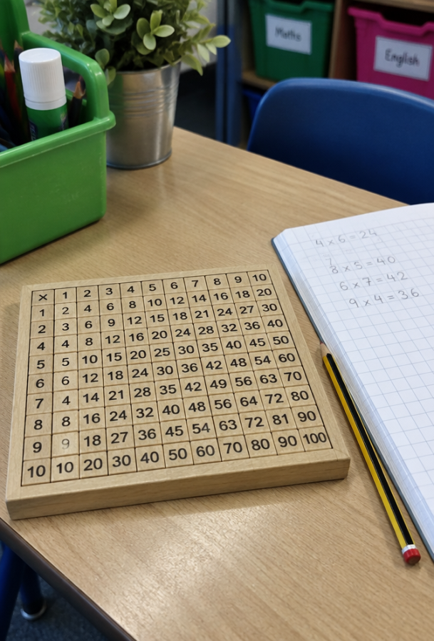
Multiplication Tables Check
June National Assessment
Statutory check ensures fluency up to 12 × 12.
Quick recall builds maths foundations.
School assessments track progress.
🔑
Key point
Find 'Times Tables Rock Stars' logins in homework books for practice.

Slide 11
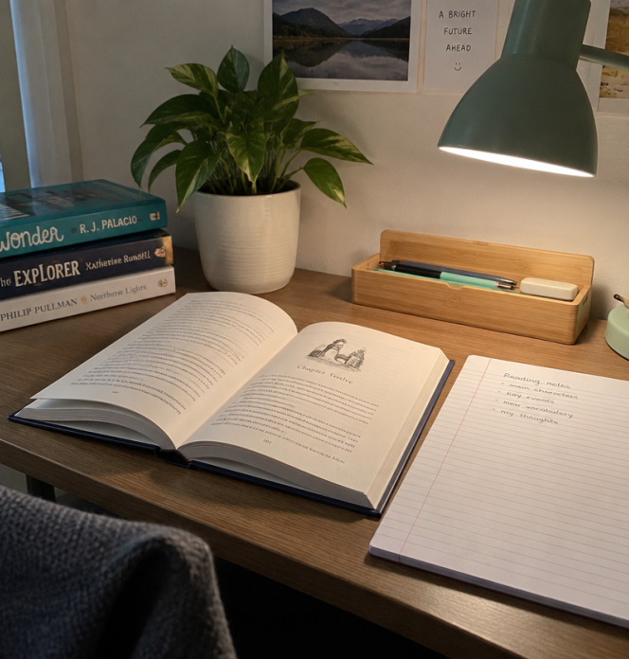
Weekly Homework Expectations
Consistent Home Routines
Short, focused sessions aid memory.
Reading: 3x weekly (5–10 mins)
Times Tables: 3x weekly (5–10 mins)
Spellings: 3x weekly in books
🔍
Homework issued Fridays; due Thursdays.

Slide 12
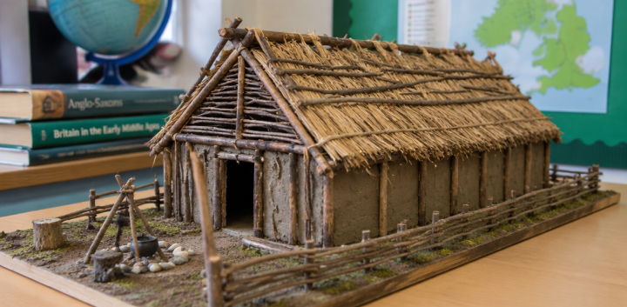
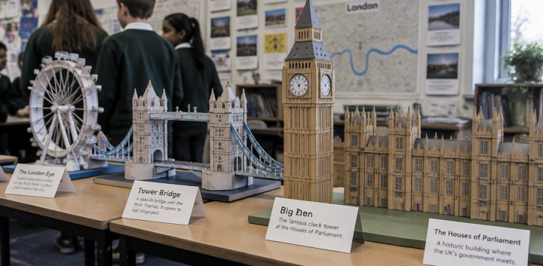
Inspiring Project Homework
Creative Freedom
Set mid-term, projects let children express learning through models, posters, or creative bakes.
Celebrating Outcomes
Projects are showcased at term-end, building pupil pride, confidence, and public speaking skills.

Slide 13
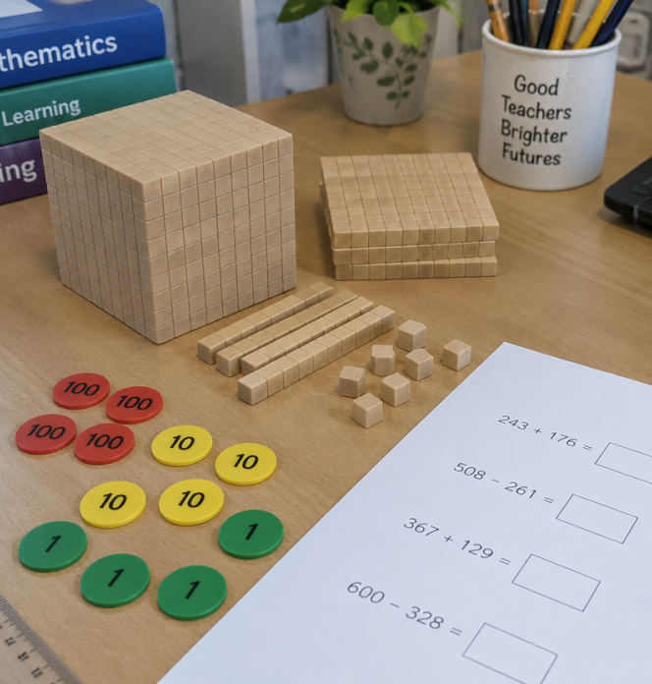
Mathematics Calculation Policy
Transparent Pedagogical Approaches
We provide complete transparency regarding our formal methods for addition, subtraction, multiplication, and division.
Access our Maths Calculation Policy via the school website's Teaching & Learning portal.
Video demonstrations show the precise step-by-step methods taught in class.
Mathematics Calculation Policies | Grange Junior School

Slide 14
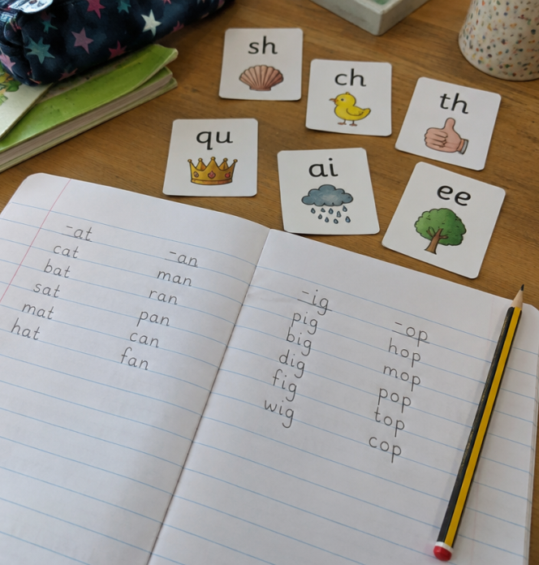
Spelling Strategies and Phonics
Structured Language Progression
Weekly tests focus either on targeted national spelling rules or the statutory 100 High Frequency Words.
New word lists are issued weekly, giving children seven days to practise.
Pupils needing structured phonetic support access Read Write Inc sessions four times weekly.

Slide 15
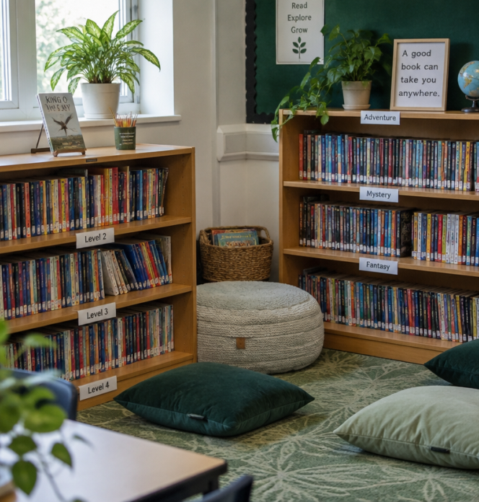
Reading Journals and Independence
Fostering Ownership
Books match reading levels. We check comprehension before changing texts.
Parents log home reading in the Reading Journal.
Journal notes provide helpful question stems.
🧠
Remember
Pupils must tell teachers when they need a new book.

Slide 16
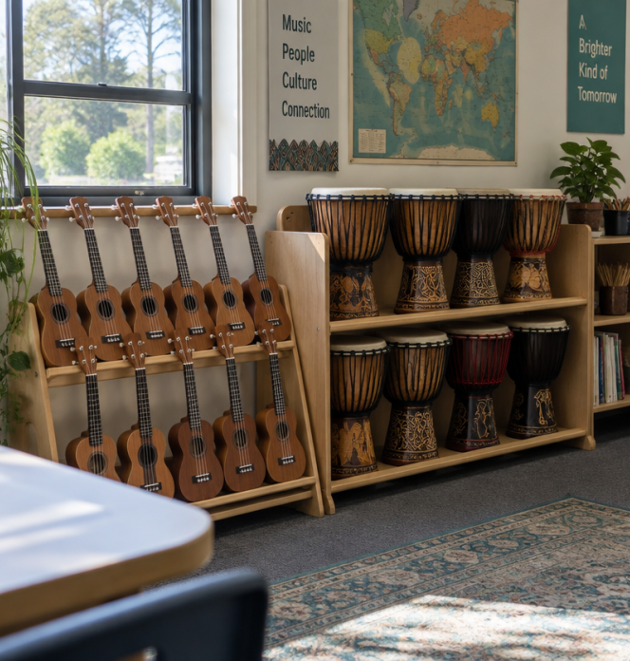
The Listen 2 Me Music Programme
Run with the Hampshire Music Service, all Year 4 pupils receive weekly, one-hour instrument tuition. Pupils discover three distinct instruments throughout the academic year.
🤯
Fun fact
Rotation features Ukulele in Autumn, a surprise in Spring, and African Percussion in Summer, ending with termly concerts.

Slide 17
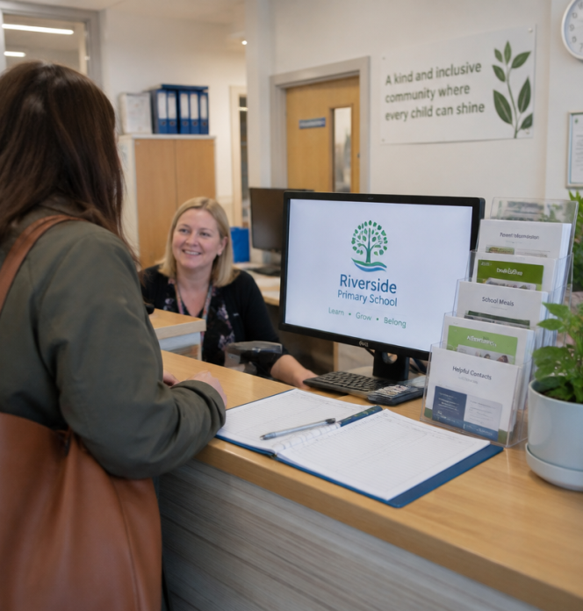
Home-School Communication Hub
Official Parents Facebook Forum
Our official closed Facebook group provides a secure digital community where parents share timely school reminders and collaborative updates.
To join, complete and return the standard parent Code of Conduct form to the school office.

Slide 18
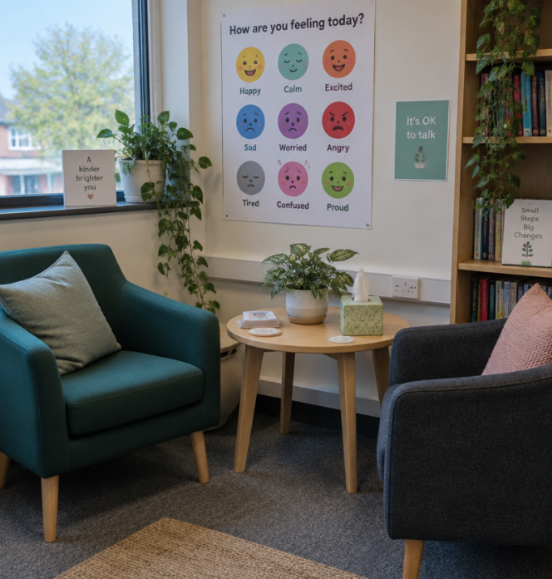
The Empowerment Approach
Curious, Not Furious
We prioritise emotional insight over punishment. We identify the unmet needs driving behaviour:
Was the classroom overwhelming?
Was the child tired, hungry, or confused?
🧠
Remember
Golden Rule: 'Good for all!'

Slide 19
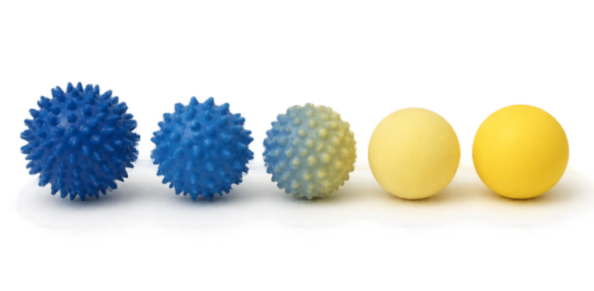

Emotional Regulation: Hold Your Prickle
Unpleasant Sensations
Represented by spiky blue spheres. Pupils learn to verbalise internal discomfort before reacting.
Pleasant States
Represented by warm yellow spheres. Pupils master self-regulation strategies to navigate emotions back to baseline.

Slide 20
Prep4Best: Proactive Success
1. Predict
Anticipate emotional, learning, and physical needs before transitions.
2. Prevent
Identify potential barriers and put calming supports in place early.
3. Plan to Succeed
Select actionable scaffolds and resources to empower confident task mastery.

Slide 21

Restorative Behaviour Management
Tree of Respect
Every child begins each morning on the fresh baseline of our Tree of Respect.
Celebration: Exceptional effort earns house points and school certificates.
Support: Initial difficulties prompt a supportive verbal check-in.
Consequences: Scaled logically as natural, educational, or protective adjustments.

